Slide 1
Chapter 4: Switched Networks
Instructor Materials
CCNA Routing and Switching
Routing and Switching Essentials v6.0
Notes:
Cisco Networking Academy Program
Routing and Switching Essentials v6.0
Chapter 4: Switched Networks

Slide 2
Instructor Materials – Chapter 4 Planning Guide
This PowerPoint deck is divided in two parts:
Instructor Planning Guide
Information to help you become familiar with the chapter
Teaching aids
Instructor Class Presentation
Optional slides that you can use in the classroom
Begins on slide # 11
Note: Remove the Planning Guide from this presentation before sharing with anyone.
Notes:
2

Slide 3
Chapter 4: Switched Networks
Introduction to Networks 6.0 Planning Guide
Notes:
Cisco Networking Academy Program
Routing and Switching Essentials v6.0
Chapter 4: Switched Networks

Slide 4
Chapter 4: Activities
What activities are associated with this chapter?
Page # | Activity Type | Activity Name | Optional?
4.0.1.2 | Class Activity | Sent or Received Instructions | Optional
4.1.1.6 | Activity | Identify Switched Network Terminology | Recommended
4.1.2.3 | Activity | Identify Switch Hardware | Recommended
4.2.1.2 | Video Demonstration | MAC Address Tables on Connected Switches | Recommended
4.2.1.6 | Activity | Frame Forwarding Methods | Recommended
4.2.1.7 | Activity | Switch It! | Recommended
4.2.2.4 | Activity | Circle the Domain | Recommended
4.3.1.1 | Class Activity | It’s Network Access Time | Optional
4.3.1.2 | Syntax Checker | Basic Switch Configurations | Recommended
Notes:
4

Slide 5
Chapter 4: Assessment
Students should complete Chapter 4, “Assessment” after completing Chapter 4.
Quizzes, labs, Packet Tracers and other activities can be used to informally assess student progress.
Notes:
5

Slide 6
Chapter 4: Best Practices
Prior to teaching Chapter 4, the instructor should:
Complete Chapter 4, “Assessment.”
The objectives of this chapter are:
Explain how data, voice, and video are converged in a switched network.
Describe a switched network in a small to medium-sized business.
Explain how frames are forwarded in a switched network.
Compare a collision domain to a broadcast domain.
Notes:
6

Slide 7
Chapter 4: Best Practices (Cont.)
4.1
Discuss the components of converged networks.
Provide examples of two-tier and three-tier network design. Evaluate your own organization’s design. Invite your IT department to present to the class.
Visit a network wiring closet to identify distribution and access layer switches.
4.2
Create a simple switched network in Packet Tracer and demonstrate how a switch builds it’s MAC addresses table.
Recommend that students watch the video on page 4.2.1.2 to reinforce their understanding.
Emphasize that switches build their tables based on the source addresses of incoming frames.
Notes:
7

Slide 8
Chapter 4: Best Practices (Cont.)
4.2
Use the simulation feature of Packet Tracer to demonstrate how frames are handled by a hub (half-duplex) compared to a switch (full-duplex). Create a topology with a hub and several PCs, send a ping from one PC to another and show how messages are handled. Replace the hub with a switch, repeat the simulation and note the differences.
Discuss how switches prevent collisions but do forward broadcasts.
Draw various network topologies and have students identify the collision domains and the broadcast domains.
Recommend that students do the interactive activity 4.2.2.4 to reinforce their understanding.
Notes:
8

Slide 9
Chapter 4: Additional Help
For additional help with teaching strategies, including lesson plans, analogies for difficult concepts, and discussion topics, visit the CCNA Community at: https://www.netacad.com/group/communities/community-home
Best practices from around the world for teaching CCNA Routing and Switching. https://www.netacad.com/group/communities/ccna
If you have lesson plans or resources that you would like to share, upload them to the CCNA Community in order to help other instructors.
Students can enroll in Introduction to Packet Tracer (self-paced)
Notes:
9

Slide 11
Chapter 4: Switched Networks
CCNA Routing and Switching
Routing and Switching Essentials v6.0
Notes:
Cisco Networking Academy Program
Routing and Switching Essentials v6.0
Chapter 4: Switched Networks

Slide 12
Chapter 4 - Sections & Objectives
4.1 LAN Design
Explain how switched networks support small to medium-sized businesses.
Explain how data, voice, and video are converged in a switched network.
Describe a switched network in a small to medium-sized business.
4.2 The Switched Environment
Explain how Layer 2 switches forward data in a small to medium-sized LAN.
Explain how frames are forwarded in a switched network.
Compare a collision domain to a broadcast domain.
Notes:
12
Cisco Networking Academy Program
Routing and Switching Essentials v6.0
Chapter 4: Switched Networks

Slide 13
4.1 LAN Design
Notes:
4 – Switched Networks
4.1 – LAN Design

Slide 14

Converged Networks Growing Complexity of Networks
Next-generation networks need to be secure, reliable, and highly available.
They must support a globalized workforce.
They must be able to integrate legacy devices.
Notes:
4.1 – LAN Design
4.1.1 – Converged Networks
4.1.1.1 – Growing Complexity of Networks

Slide 15
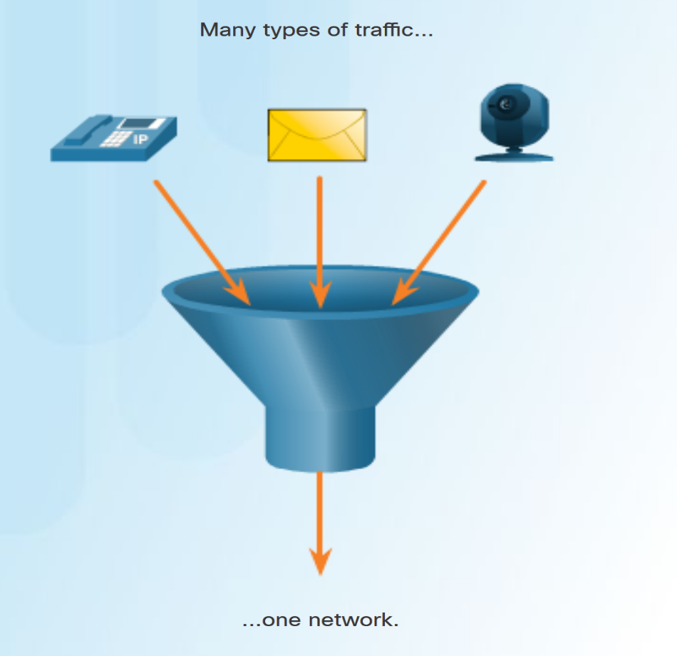
Converged Networks Elements of a Converged Network
Converged network solutions integrate voice systems, IP phones, voice gateways, video support, and video conferencing.
Primary benefit of the converged network - just one physical network to install and manage.
Notes:
4.1 – LAN Design
4.1.1 – Converged Networks
4.1.1.2 – Elements of a Converged Network

Slide 16
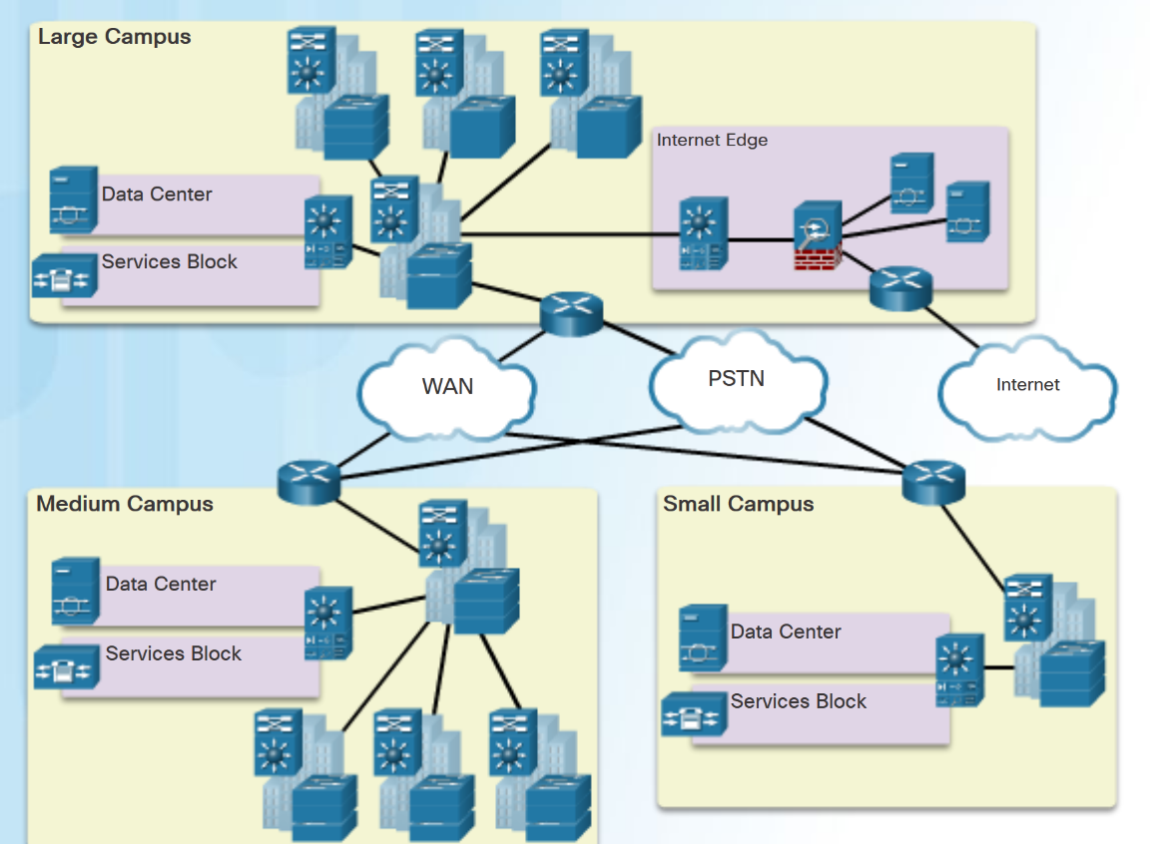
Converged Networks Cisco Borderless Networks
The Cisco Borderless Network has the following features:
Allows organizations to connect anyone, anywhere, anytime, on any device; securely, reliably, and seamlessly.
Provides the framework to unify wired and wireless access, including policy, access control, and performance management across many different device types.
Provides network services, and user and endpoint services that are all managed by an integrated management solution.
Notes:
4.1 – LAN Design
4.1.1 – Converged Networks
4.1.1.3 – Cisco Borderless Networks

Slide 17
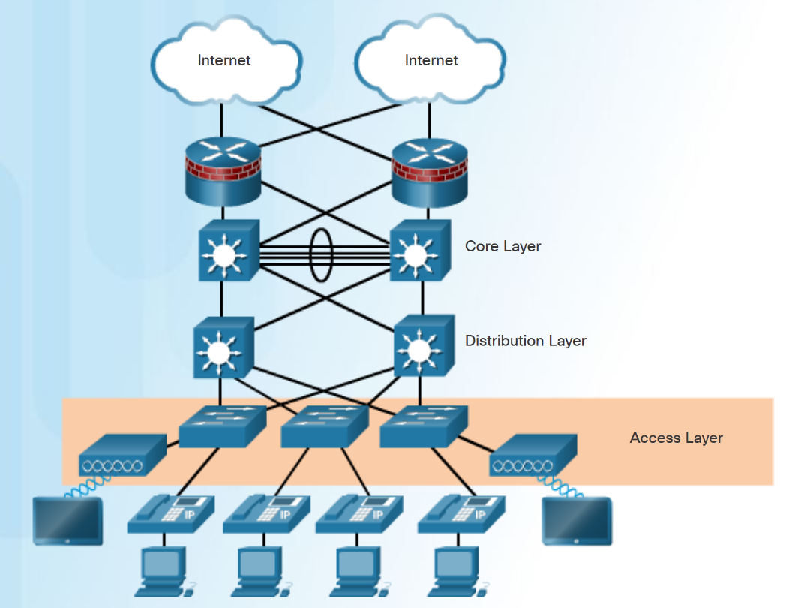
Converged Networks Hierarchy in the Borderless Switched Network
Borderless switched network design guidelines are based on the following principles:
Hierarchical - Facilitates understanding the role of each device at every tier.
Modularity - Allows seamless network expansion and integrated services.
Resiliency – Provides an always available network.
Flexibility - Allows intelligent traffic load sharing.
The three tiers of the hierarchical model are Access, Distribution and Core layers.
Notes:
4.1 – LAN Design
4.1.1 – Converged Networks
4.1.1.4 – Hierarchy in the Borderless Switched Network

Slide 18
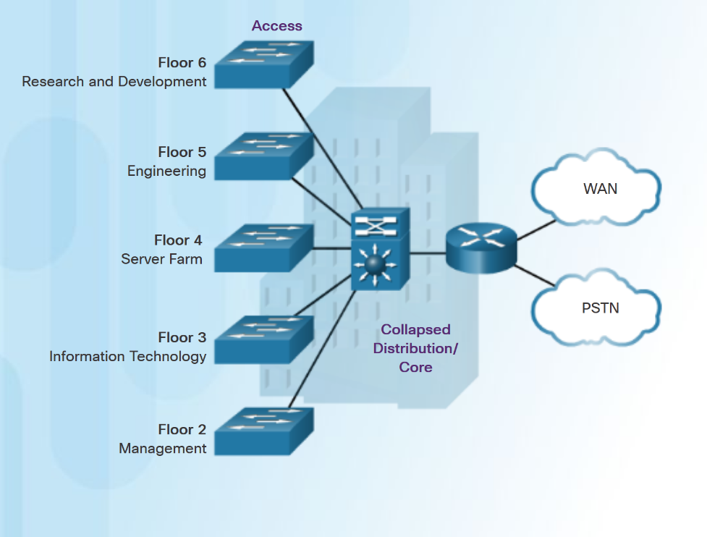
Converged Networks Access, Distribution, and Core Layers
Access Layer – provides network access to the user.
Distribution Layer - interfaces between the access layer and the core layer. Provides functions such as:
aggregating Layer 2 broadcast domains and Layer 3 routing boundaries.
providing intelligent switching, routing, and network access policy functions to access the rest of the network.
Core Layer - is the network backbone. It provides fault isolation and high-speed backbone connectivity.
Smaller networks that do not need a separate distribution and core layer often use a two-tier campus or collapsed core network design.
Notes:
4.1 – LAN Design
4.1.1 – Converged Networks
4.1.1.5 – Access, Distribution, and Core Layers

Slide 19
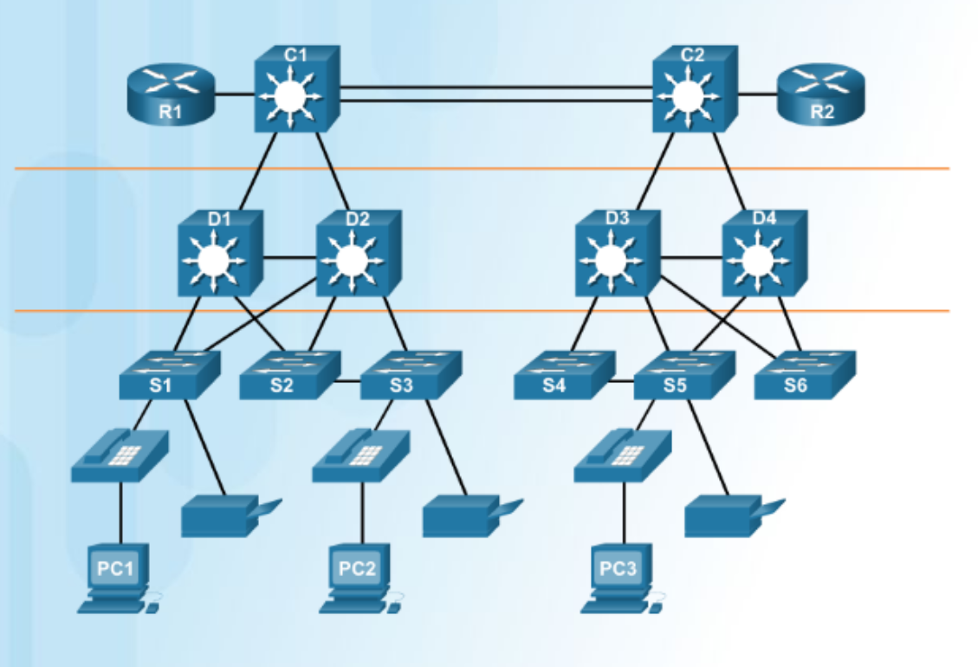
Switched Networks Role of Switched Networks
A hierarchical switched LAN allows more flexibility, traffic management, and additional features:
Quality of service
Additional security
Support for wireless networking and connectivity
Support for new technologies.
Notes:
4.1 – LAN Design
4.1.2 – Switched Networks
4.1.2.1 – Role of Switched Networks

Slide 20
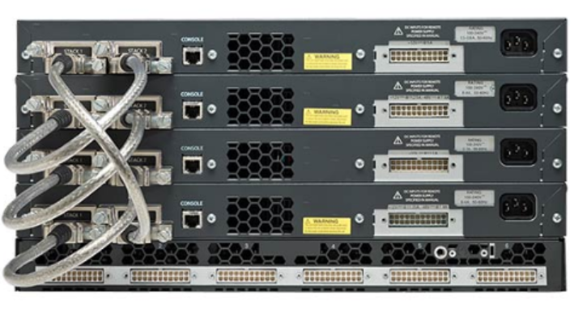
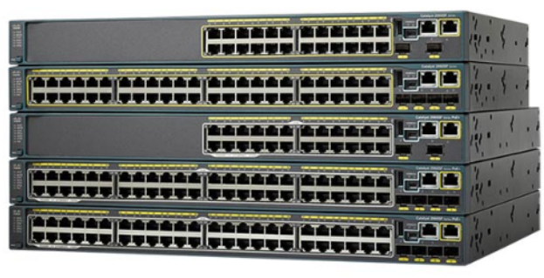
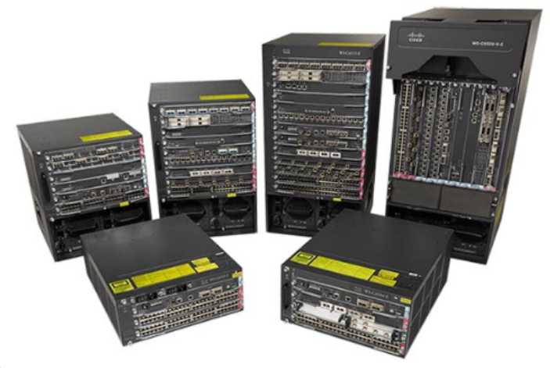
Switched Networks Form Factors
Stackable Configuration
Fixed Configuration
Considerations when selecting switches:
Cost
Port Density
Power
Reliability
Port Speed
Frame buffers
Scalability
Modular Configuration
Notes:
4.1 – LAN Design
4.1.2 – Switched Networks
4.1.2.2 – Form Factors

Slide 21
4.2 The Switched Environment
Notes:
4 – Switched Networks
4.2 – The Switched Environment

Slide 22
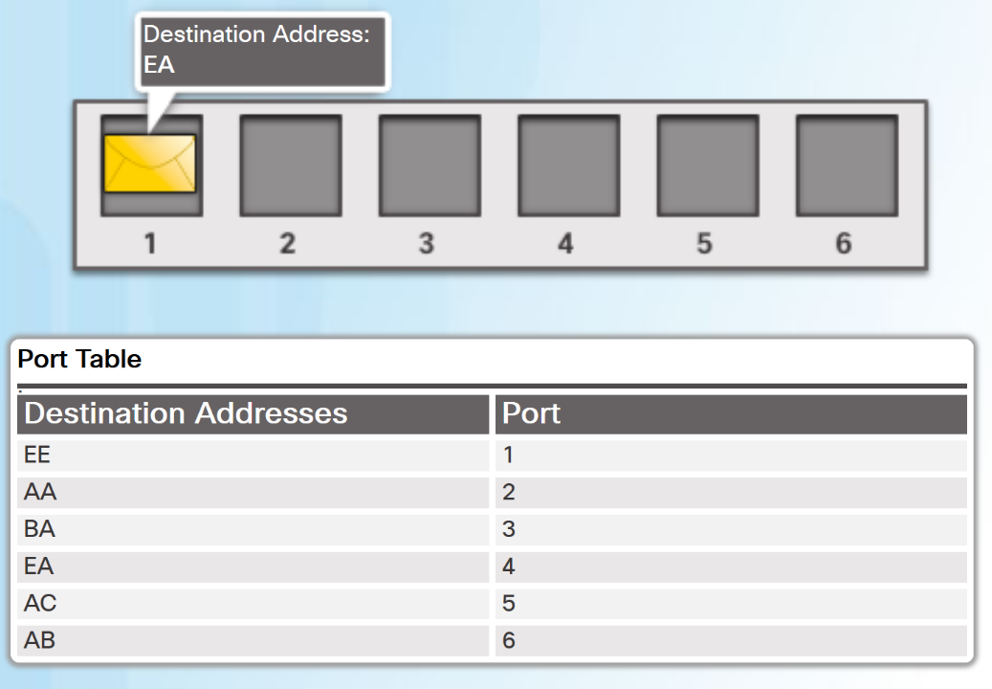
Frame Forwarding Switching as a General Concept in Networking and Telecommunications
A LAN switch makes decisions based on two criteria:
Ingress port - where a frame enters the device
Destination address
A LAN switch maintains a table that it uses to determine how to forward traffic.
In the diagram, If a message enters switch port 1 with a destination address of EA, then the switch forwards the traffic out port 4.
Layer 2 Ethernet switches forward frames based on the destination MAC address.
Notes:
4.2 – The Switched Environment
4.2.1 – Frame Forwarding
4.2.1.1 – Switching as a General Concept in Networking and Telecommunications

Slide 23
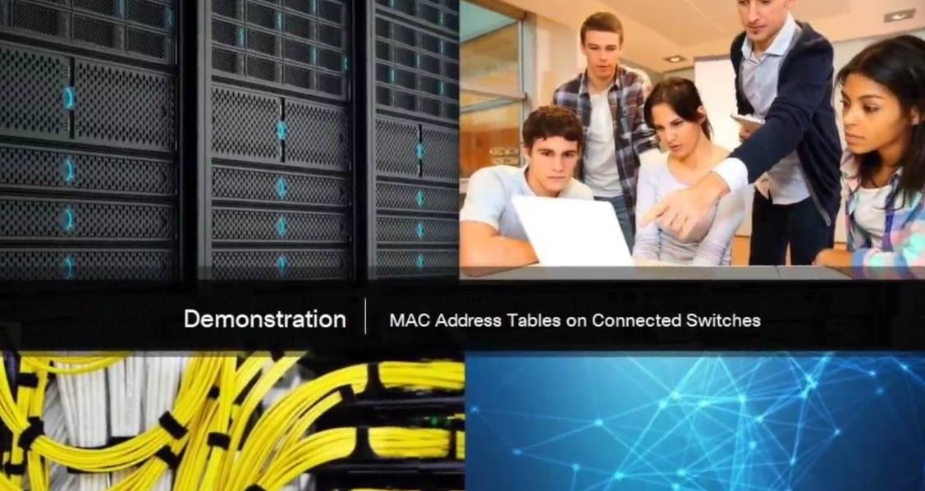
Frame Forwarding Video Demonstration - MAC Address Tables on Connected Switches
The video explains how a switch builds its MAC address table by recording the MAC address of each device connected to each of its ports.
Notes:
4.2 – The Switched Environment
4.2.1 – Frame Forwarding
4.2.1.2 – Video Demonstration - MAC Address Tables on Connected Switches

Slide 24
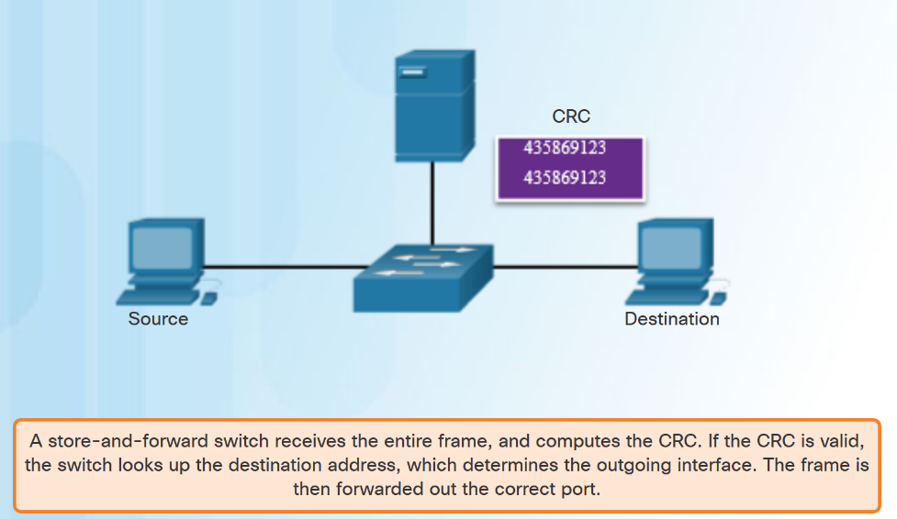
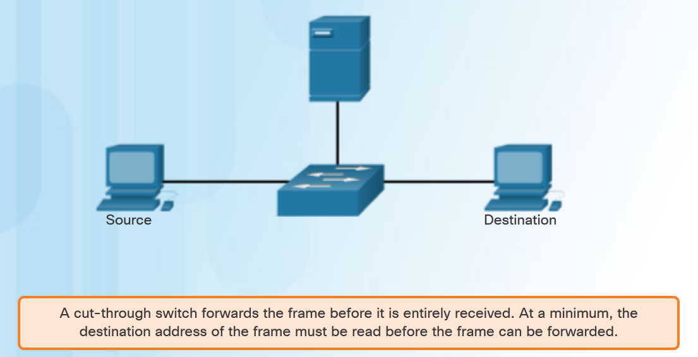
Frame Forwarding Switch Forwarding Methods
Notes:
4.2 – The Switched Environment
4.2.1 – Frame Forwarding
4.2.1.3 – Switch Forwarding Methods

Slide 25
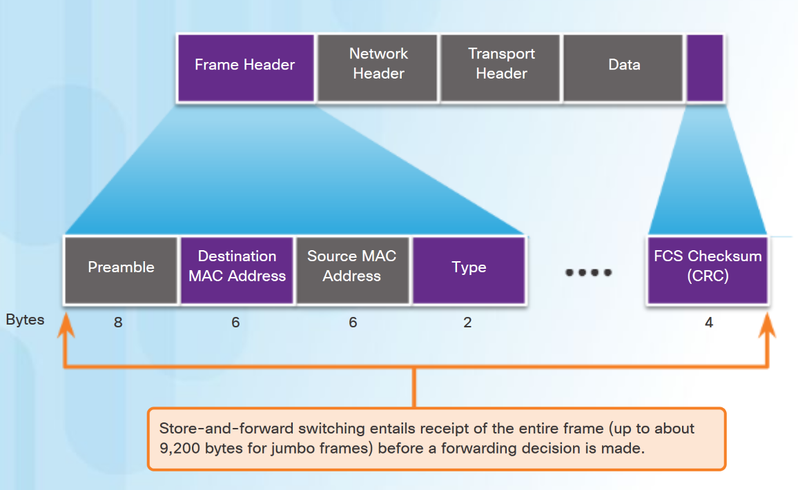
Frame Forwarding Store-and-Forward Switching
Features of Store-and-Forward Switching:
Error Checking– After receiving the entire frame, the switch compares the frame-check-sequence (FCS) value in the last field against its own FCS calculations. Only error-free frames are forwarded
Automatic Buffering– ingress port buffering provides the flexibility to support any mix of Ethernet speeds.
Store-and-Forward is Cisco’s primary LAN switching method.
Notes:
4.2 – The Switched Environment
4.2.1 – Frame Forwarding
4.2.1.4 – Store-and-Forward Switching

Slide 26
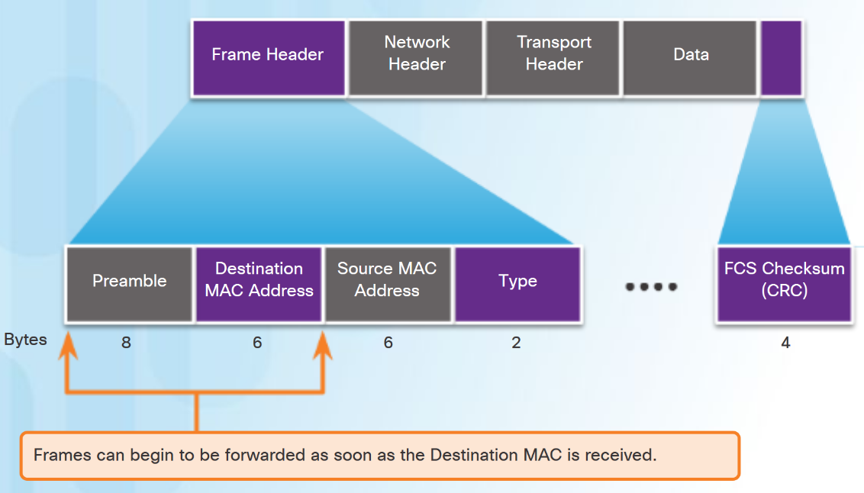
Frame Forwarding Cut-Through Switching
Rapid Frame Forwarding - The switch can make a forwarding decision as soon as it has looked up the destination MAC address.
Frames with errors are forwarded.
Fragment Free - modified form of cut-through switching. The switch waits for the collision window (64 bytes) to pass before forwarding the frame.
Provides better error checking than cut-through, with practically no increase in latency.
Notes:
4.2 – The Switched Environment
4.2.1 – Frame Forwarding
4.2.1.5 – Cut-Through Switching

Slide 27
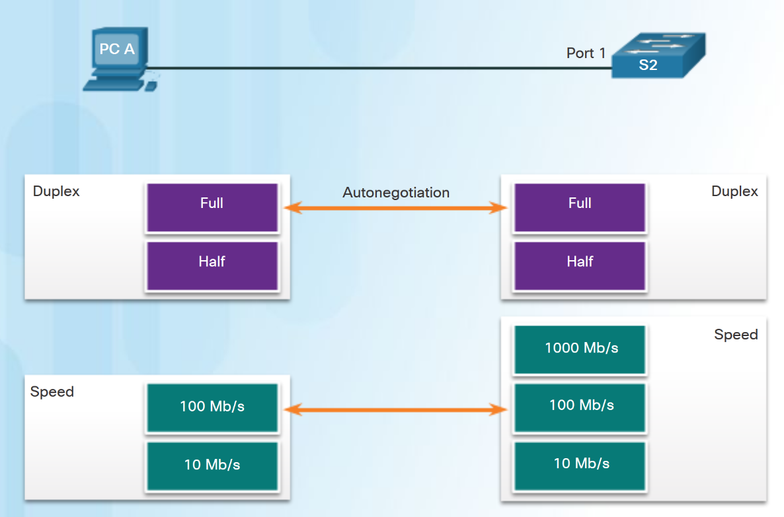
Switching Domains Collision Domains
In hub-based Ethernet segments, network devices compete for the medium, therefore collisions will occur.
Ethernet switch ports operating in full duplex eliminate collisions.
Ethernet switch ports will autonegotiate full-duplex if connected to full-duplex device.
If connected to a half-duplex device then the switch port will operate in half duplex and be part of a collision domain.
Notes:
4.2 – The Switched Environment
4.2.2 – Switching Domains
4.2.2.1 – Collision Domains

Slide 28
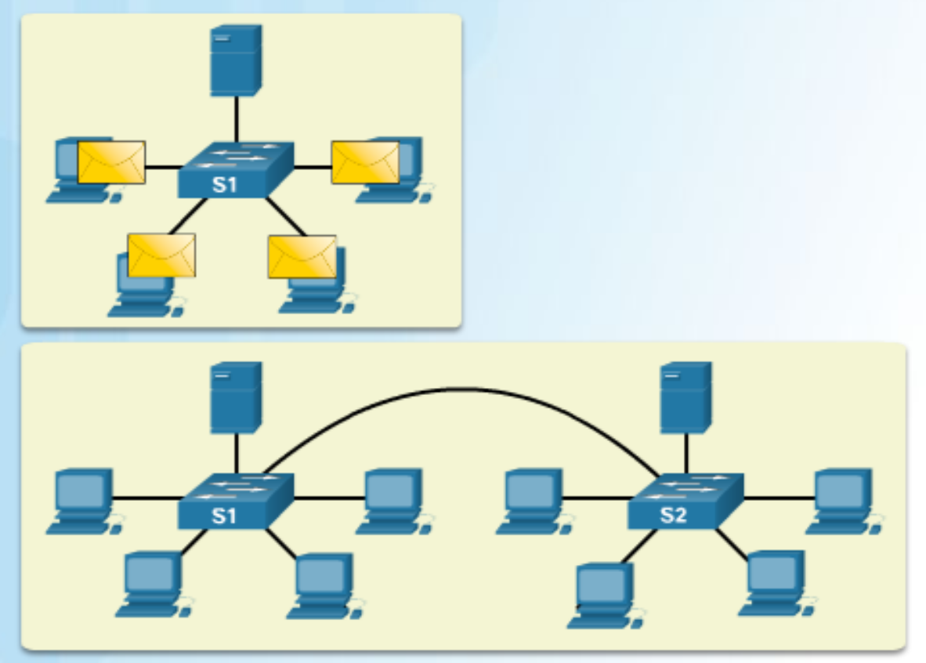
Switching Domains Broadcast Domains
One switch or multiple interconnected switches form a single broadcast domain.
When a switch receives a broadcast frame, it forwards the frame out each of its ports, except the ingress port where the broadcast frame was received.
When two switches or more switches are connected together, the broadcast domain is increased because the broadcast is propagated from switch to switch.
Too many broadcasts can cause network congestion.
Notes:
4.2 – The Switched Environment
4.2.2 – Switching Domains
4.2.2.2 – Broadcast Domains

Slide 29
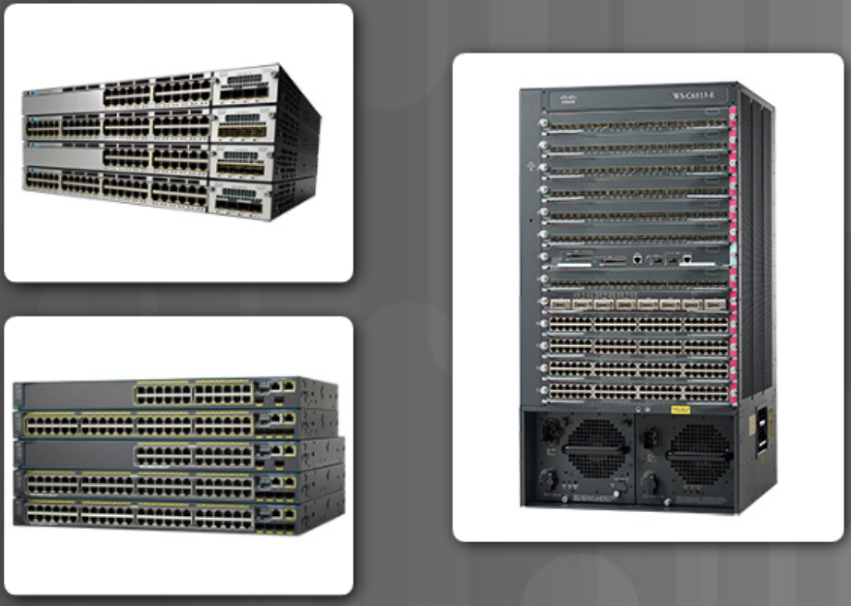
Switching Domains Alleviating Network Congestion
The following characteristics of switches help alleviate congestion:
Establishing full-duplex links, therefore eliminating collisions.
High port density
Large frame buffers
Port speed
Fast internal switching
Low per-port cost
Notes:
4.2 – The Switched Environment
4.2.2 – Switching Domains
4.2.2.3 – Alleviating Network Congestion

Slide 30
4.3 Chapter Summary
Notes:
4 – Switched Networks
4.3– Summary

Slide 31
Conclusion Chapter 4: Switched Networks
Explain how switched networks support small to medium-sized businesses.
Explain how Layer 2 switches forward data in a small to medium-sized LAN.
Notes:
4.3 – Summary
4.3.1 – Conclusion
4.3.1.3 – Chapter 4: Switched Networks

Slide 32
Switched Networks New Terms and Commands
form factors
Fixed configuration switches
Modular configuration switches
line cards
Stackable configuration switches
ingress
egress
MAC address table
content addressable memory (CAM) table
Ethernet bridges
application-specific-integrated circuits (ASICs)
store-and-forward switching
cut-through switching
cyclic redundancy check (CRC)
egress port
network
Call control
Automated attendant
PC softphone
Cisco Borderless Network
collapsed core layer model
three layer hierarchical model
access layer
distribution layer
core layer
Port Density
Frame Buffers
Scalability
rack units
Notes:
New Terms and Commands

Slide 33
Switched Networks New Terms and Commands (Cont.)
frame-check-sequence (FCS)
buffer
rapid frame forwarding
fragment free
Fragment free switching
collision domains
broadcast domains
full duplex
autonegotiate
half duplex
High port density
Notes:
New Terms and Commands

